Slide 1

ENTEVYUV 10.0
COMMENT2LIKES: ESTIMATING VIDEO LIKES USING COMMENT DATA
Presented by Vinodhini Rajamanickam

Slide 2
Index
Topic Highlights
Problem Statement
Project aim
Tools Used
Project Processes (step wise)
Approaches
Exploratory Data Analysis (EDA) Insights
Model Performance Evaluation
Conclusion

Slide 3
PROBLEM STATEMENT .
Content creators, marketers, and platform administrators lack a reliable tool to estimate the potential popularity of their videos based on comment information.

Slide 4


to develop a machine learning model that predicts video popularity using comments, empowering decision-making, content optimization, and marketing strategies on video-sharing platforms.
Project's Aim

Slide 5
PROGRAMMING LANGUAGE
Python
IDE
Jupiter Notebook
DATA LOADING AND MANIPULATION
Pandas
DATA VISUALIZATION
Matplotlib, Seaborn
MACHINE LEARNING
scikit-learn
NATURAL LANGUAGE PROCESSING
Tools Used
NLTK

Slide 6
REGULAR EXPRESSION
re
TEXT VECTORIZATION AND FEATURE EXTRACTION
Count Vectorizer
DATA SCALING
Standard Scaler
ML ALGORITHM
Decision Tree Regressor
Random Forest Regressor
Gradient Boosting Regressor
EVALUATION METRICS
Mean Squared Error(MSE)
Mean Absolute Error(MAE)
R2 score
Tools Used

Slide 7



PHASE 1
PHASE 2
PHASE 3
Importing necesssary libraries
Loading Data
View Data
Getting to know the data
Data Merging
SInce there are two datasets, merging is necessary
Data Cleaning
Remove unnecessary features
Rename columns
handle null values
Handle regular expressions
PROJECT PROCESS

Slide 8


PHASE 4
PHASE 5
PHASE 6
Exploratory Data Analysis
Exploring the data and getting insights from them
Define X and y
separating data into X and y (Target Variable)
Preprocessing
Remove unnecessary space, symbols, numbers etc.
Remove stopwords
Lemmatize the text
PROJECT PROCESS

Slide 9


PHASE 7
PHASE 8
PHASE 9
Vectorization and Feature Extarction
Turn the text into numerical form and extract a range of features
Train Test Split
Split the data into 80% train and 20% test dataset
Scaling
As the data shows a range of variations Scaling is a option to normalize the data
PROJECT PROCESS

Slide 10
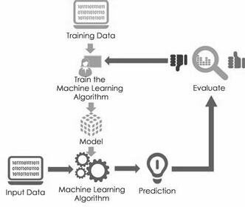


PHASE 10
PHASE 11
PHASE 12
Model Training and Evaluation
train the model on different algorithms and evaluate the model using MSE, MAE and R2 score
Model Comparison
Compare the models according to their performaces
Final Model
Finalize the best performing model.
PROJECT PROCESS

Slide 11
Approaches
DATA CLEANING
PREPROCESSING
cleaning data is a necessary part in any ML project.
Remove Features
(Unnamed: 0_x, Unnamed: 0_y, Published At)
Rename Columns
(Likes_x to Video likes, Likes_y to comment likes).
Handle null values
few columns cannot be filled using any methods(eg. Comment) and target variable(Video Likes), it is better to remove them.
Remove unnecessary space
Remove stopwords.
(I, a, an, is,the ,and, etc.)
Lemmatize the text
(smiling, smiles, smiled---> smile)

Slide 12
Approaches
VECTORIZATION AND FEATURE EXTRACTION
SCALING
the features showed a range of variations. which needed scaling. Compared two different techniques:
StandardScaler
MinMaxScaler
selected standard Scaler for scaling.
applied and compared two different vectorization techniques :
Count vectorizer
TF-IDF Vectorizer
selected count vectorizer, as this showed better performance after comparison from (96% to 99%)
for feature extraction used max_features method.

Slide 13
Exploratory Data Analysis
40
30
Insights
20
10
0
Item 1
Item 2
Item 3
Item 4

Slide 14
Title with highest number of comments
Title with lowest number of comments
El Chombo | Dame Tu Cosita feat. Cutty Ranks | Official Video | Ultra Music
BEST Auditions Of Songs From Movies Amazing Auditions
Title with most number of likes
Title with least number of likes
El Chombo | Dame Tu Cosita feat. Cutty Ranks | Official Video | Ultra Music
How To Build A Business That Works Brian Tracy | GENIUS
Title with most number of views
Title with least number of views
l Chombo | Dame Tu Cosita feat. Cutty Ranks | Official Video | Ultra Music.
Mathematics and Chemistry MathChemistry.com | Masters Degree in Math

Slide 15
Title with most
Positive sentiments
neutral sentiments
Champions Chess Tour FTX Crypto Cup Day Commentary by David Jovanka Kaja | amp Simon
D P CHEZ VOUS Ces PROMOS disparaissent bient t du PS Store Xbox Store Nintendo eShop
Negative sentiments
Nightly News Full Broadcast Aug

Slide 16
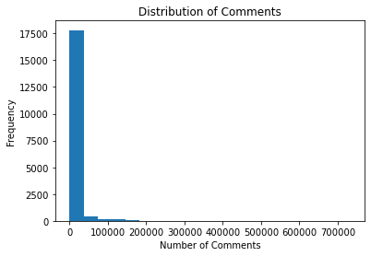
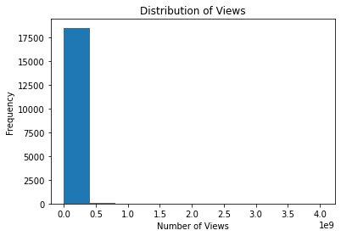
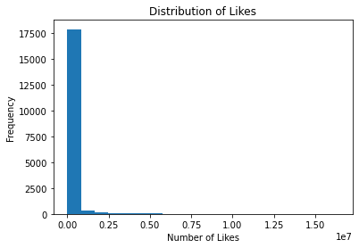
Visualizations

Slide 17
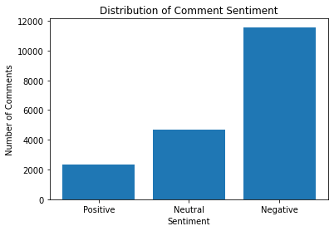
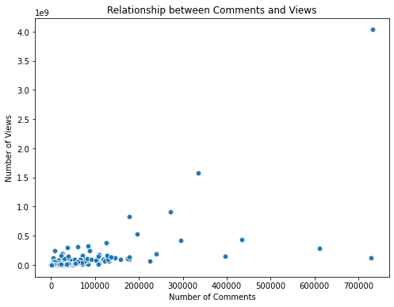
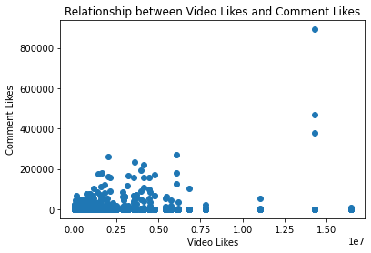
Visualizations

Slide 18
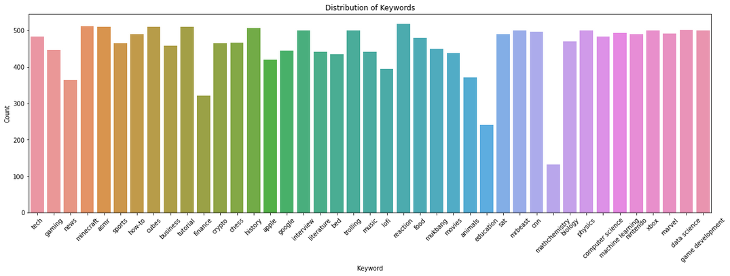
Visualizations
Keywords

Slide 19
MODEL PERFORMANCES AND EVALUATION
Comparing Different models
DECISION TREE
RANDOM FOREST
GRADIENT BOOSTING
MAE:
1124419410.13664
MSE :
7154.4537125500
R2 score :
0.9982
MAE:
7387141277.98380
MSE :
33273.009188345066
R2 score :
0.9887
MAE:
80026413.019835
MSE :
2546.195794183445
R2 score :
0.9988

Slide 20
99.8%
Accuracy of the model
RANDOM FOREST REGRESSOR

Slide 21
Thank you
NAME
Vinodhini Rajamanickam
COURSE
Master Data Science
BATCH
D50

